Slide 1

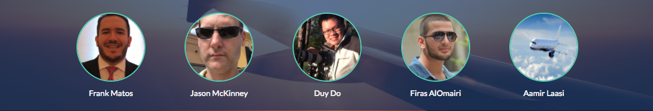
Mavericks Flight Tracking Mobile App

Slide 2
Meet our team
Aamir – SCRUM & Project Manager
Duy – Front End
Frank – Front End
Firas – Back End
Jason – Back End
Notes:
Frank - Introduction

Slide 3
Objectives
Problem we are solving
Proposed Solution
Front End (UI/UX)
Technologies
Back End (APIs)
DEMO
Q&A
Notes:
Frank - Agenda

Slide 4
PROBLEM
Notes:
Frank - Problem
Nowadays, going through a busy airport can be an adventure. Here is Houston for example, we need to account for traffic, which can easily make you late for your flight. Sometimes you need park miles away, check in, go through TSA, walk some more to get to your gate. Let’s not forget the lines and you’re luck if you find a seat to wait for boarding. We need to be diligent to make sure to be at the gate on time.

Slide 5
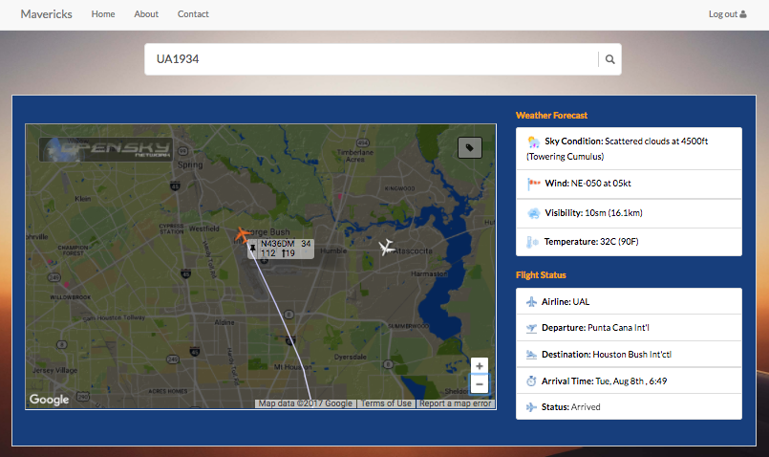
SOLUTION
Notes:
Frank & Duy – Solution (Front End)
Our goal was to create an app that was functional, an app that would allow someone to track their flight live, departure, arrival, flight status, as well as weather information and geolocation for the aviation enthusiast.
With our app, you can track you flight, airport weather information a map where you can track flight live. Aviation enthusiasts can can track flight any where in the world, see flight details information as well as weather information, which is the critical piece of information in aviation.
Tracking your loved ones
Checking Weather – Origin and Destination

Slide 6
Technologies Used
Wireframe.cc – App Layout
ICAO – Airport Info
FlightAware – Flight Status
AVWX – Weather
OpenSky – Map
JQuery Rigid Autocomplete
AVWX
Notes:
Aamir – Technologies (Back end explanation)
*Make sure to mention the 2 new technologies, Wireframe and Jquery Autocomplete.

Slide 7
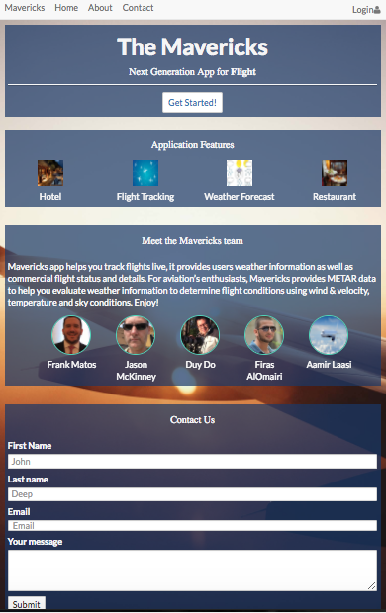
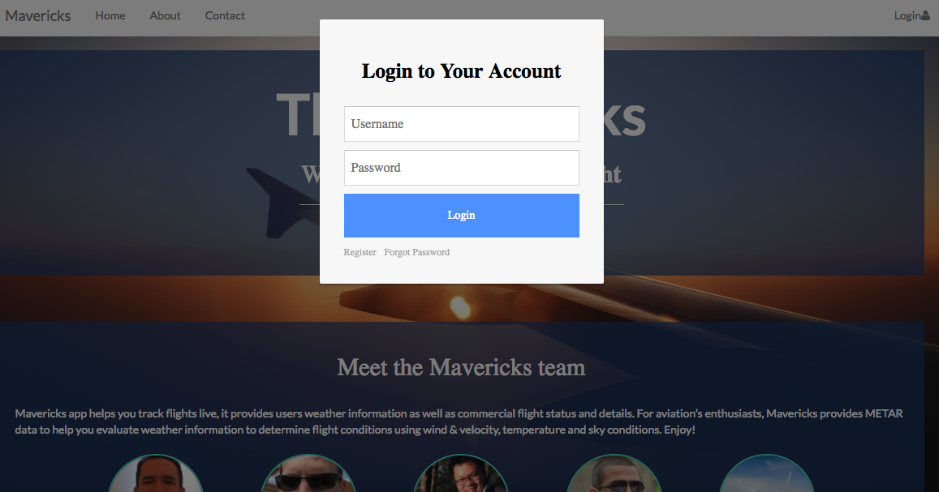
Front End

Slide 8
DEMO
Notes:
Jason & Faris

Slide 9
Q&A

